Slide 1
Project dentrite

Slide 2
Problem statement
Create tool to validate if keyboard is working or not working.
Notes:
1. Define Problem Statement
2. Explain

Slide 3
Problem solution
Train a model to classify images of keyboard
Categorize working keyboards against faulty keyboards
Notes:
1. Define Problem Statement
2. Explain

Slide 4
What is image classification?
Process of labelling and organizing images
Labels are assigned based on the images’ features
Generate a faulty (0) or working (1) result after prediction
Notes:
1. Define Problem Statement
2. Explain

Slide 5
Technology used
Convolutional neural networks (CNNs); typically used for image processing
Useful for learning special features such as edges, textures and shapes
Data Balancing technique
Notes:
1. Define Problem Statement
2. Explain

Slide 6
Technology used
‘working’ has more images than ‘faulty’
Sklearn.utils.class_weight.Compute_class_weight ()
Estimate class weights for unbalanced datasets
Ensures that less frequent class gets higher weight
Higher weight results in more importance given to that class during training
Notes:
Original Dataset:
y_batch1 = tf.constant([0,1,1]) # Labels for batch 1
y_batch2 = tf.constant([0, 1, 0]) # Labels for batch 2
Firstly, Flatten
[y.numpy().flatten() for _, y in train_ds]
Result: [array([0, 1, 1]), array([0, 1, 0])]
Lastly, Concatenate
labels = np.concatenate([array([0, 1, 1]), array([0, 1, 0])], axis=0)
array([0, 1, 1, 0, 1, 0])

Slide 7
Technology used (Transfer Learning)
4 Processes used
GlobalAvgPool2D
Dense(512)
Dropout
Dense

Slide 8
Technology used (w/o xfer learning)
4 Processes used
Conv2D
MaxPooling2D
Flatten
Dense

Slide 9
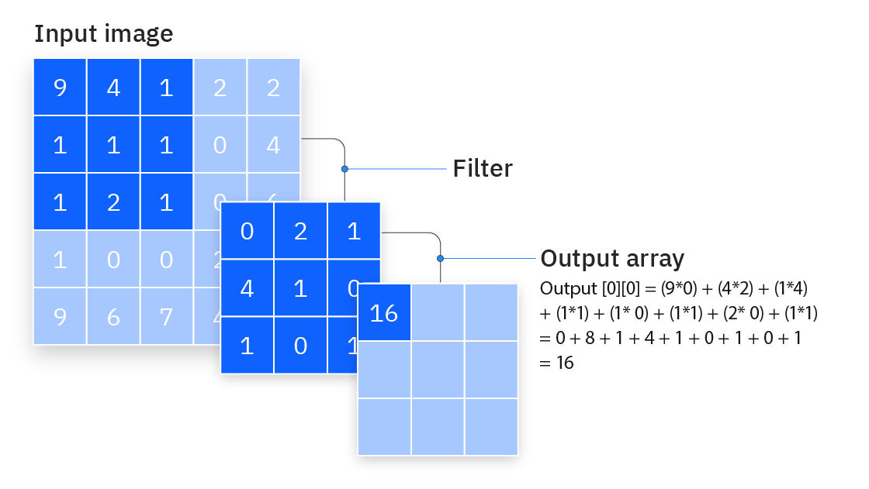
Technology used
Conv2D
Core building block of CNN
Extracts special features of images (textures, edges, shapes)
Filter moves across image and detect patterns
Generates a Feature Map
Conv2D
MaxPooling2D
Flatten
Dense
Notes:
https://www.ibm.com/content/dam/connectedassets-adobe-cms/worldwide-content/creative-assets/s-migr/ul/g/ed/92/iclh-diagram-convolutional-neural-networks.png

Slide 10
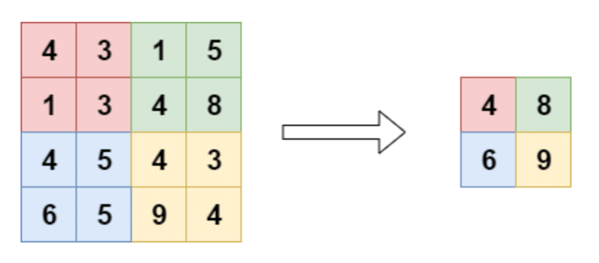
Technology used
MaxPooling2D
Down samples feature map while retaining important information
Applies max() of each region in Feature Map
E.g., if feature map is 4x4, it will be reduced to 2x2
Conv2D
MaxPooling2D
Flatten
Dense
Notes:
https://www.researchgate.net/publication/344331692/figure/fig11/AS:965939822620684@1607309408773/Pooling-layer-The-pooling-layer-performs-a-downsampling-operation-along-the-spatial.ppm

Slide 11
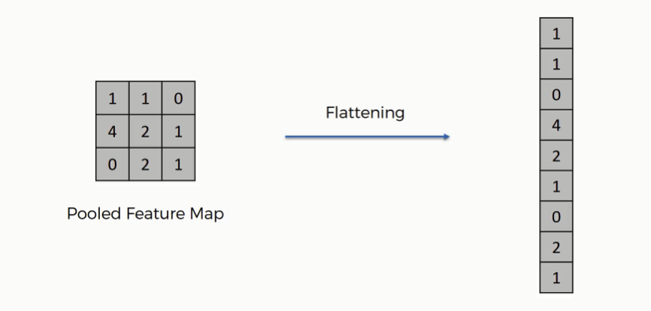
Technology used
Flatten
Takes output from Convolutional and Pooling operations and flattened into 1D vector
Conv2D
MaxPooling2D
Flatten
Dense
Notes:
https://sds-platform-private.s3-us-east-2.amazonaws.com/uploads/73_blog_image_1.png

Slide 12
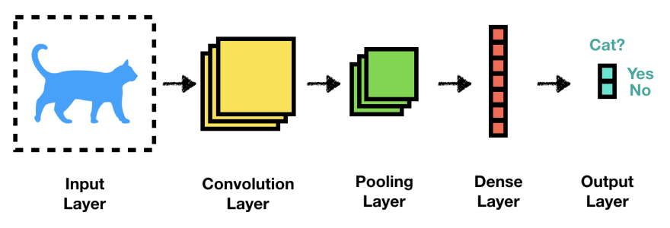
Technology used
Dense
Takes the 1D vector and perform predictions
Conv2D
MaxPooling2D
Flatten
Dense
Notes:
https://media.licdn.com/dms/image/v2/C4E12AQHa0As6OhBIFQ/article-cover_image-shrink_600_2000/article-cover_image-shrink_600_2000/0/1567401067125?e=2147483647&v=beta&t=mgyh8O5m9cQ9a6VKrATsKDSb5scH410RWZFDjATaOLM

Slide 13



Project flow
Training
Conv2D
MaxPooling2D
Flatten
Dense
Image
Model

Slide 14


Project flow
Faulty
Result
Image
Model
Working

Slide 15
demo

Slide 16
end

